Slide 1
Def Final_Project(project):
If project isdoneby(Zack_DeNoto):
call enjoy_this_project

Slide 2
Vaccinations
Vaccinations are currently a topic many people have an opinion on and is in the media
I looked into vaccinations in schools between 2016-2017 for over 2400 schools ranging from pre-k to 12th grade
My question is to see if there is a relationship between vaccination exemptions and schools with certain grades like kindergarten and 6th grade

Slide 3
Variables
K_12_enrollment
Percent_complete_for_all_immunizations
Percent_with_any_exemption
Number_with_medical_exemption
Number_with_personal_exemption
Number_with_religious_exemption
Has_kindergarten
Has_6thGrade

Slide 4
Description of the 5 variables
K_12_enrollment: The number of children at the school.
Percent_complete_for_all_immunizations: The percentage of children with all vaccinations.
Percent_with_any_exemption: Percentage of children with an exemption for vaccinations
Number_with_medical_exemption: The number of children that have medical exemptions for not getting vaccinated.

Slide 5
Description of the 5 variables(continued)
Number_with_personal_exemption: The number of children that have personal exemptions for not getting vaccinated.
Number_with_religious_exemption: The number of children that have religious exemptions for not getting vaccinated.
Has_Kindergarten: Yes(Y) or no(N) for if the school has kindergarten
Has_6thGrade: Yes(Y) or no(N) for if the school has 6th grade

Slide 6
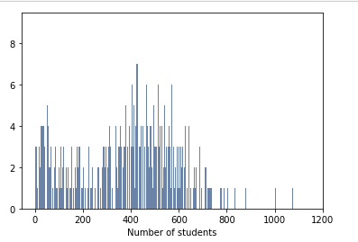
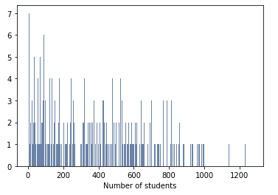
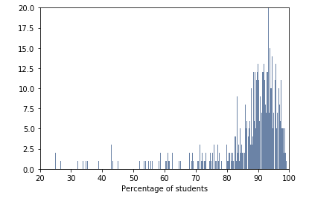
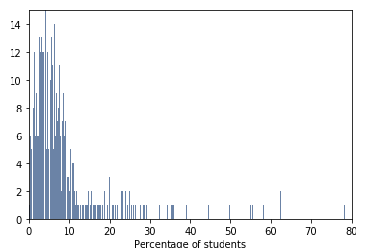
Histogram of variables
Schools with kindergarten
Schools with 6th grade
Schools with kindergarten with all immunizations
Schools with 6th grade with any exemptions

Slide 7
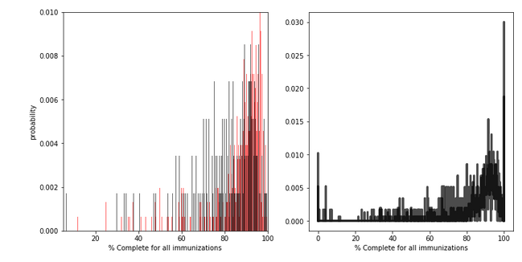
PMF
Schools with kindergarten in them(red) tend to have a higher percentage of students with all immunizations compared to schools with 6th grade(black)

Slide 8
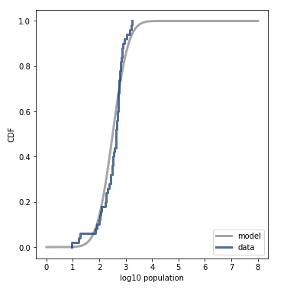
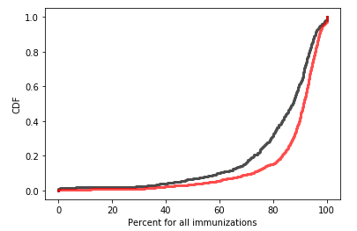
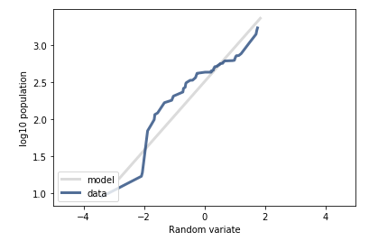
CDF/Analytical Distribution
The black and red in the first chart represent the same groups as the previous slide. As you can tell, the chart matches what we noticed using PMF. The chart of the left shows us that the data isn’t the best fit for normal probability and was be better suited for a logarithmic model from the chart on the right.

Slide 9
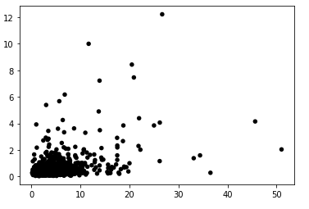
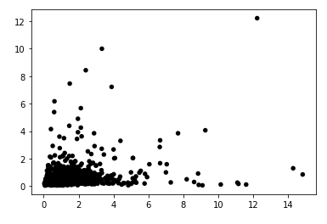


Scatterplots
Personal and religious exemptions
Medical and religious exemptions
The scatterplots of the highest and lowest correlation show that the highest correlation between personal and religious exemptions at 0.422 is not very strong and the weakest relationship was found between medical and religious exemptions. This shows us that of the variables there is not a strong relationship between any of them.

Slide 10
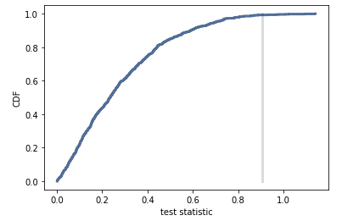
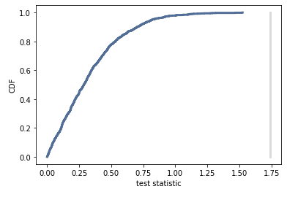
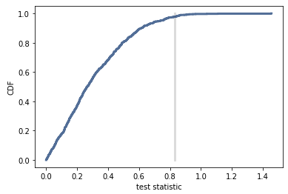
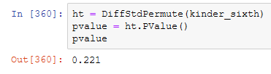
Hypothesis Testing
Here we would reject the null hypothesis that there is a difference between percent of students with any exemptions when comparing schools with kindergarten and schools with 6th grade due to the low values. Though that may change if we had made our test more specific

Slide 11
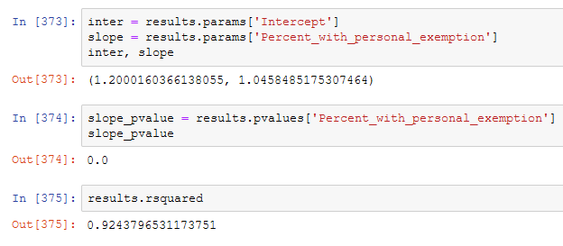
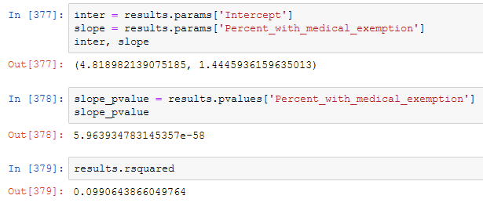
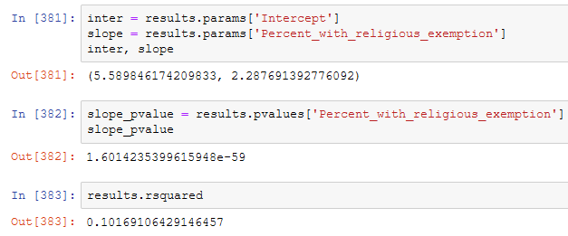
Regression
Based on the three regression models, we can see that there mixed results from comparing the relationship between the three variables. However we notice a slop of 0.0 for personal and any exemption, whereas the largest slope was when comparing medical exemption and any exemption

Slide 12
Conclusion
There are many mixed results depending on the tests run and the variables. However, it appears that based on the tests overall, there is no large statistical difference based on the dataset and tests if we are comparing schools with kindergarten and schools with 6th grade for vaccination exemptions.

